Slide 1
RADAR Coverage Survey ToT - Using mapping materials for data collection
Notes:
1

Slide 2
Overview mapping
Objective:
Create a complete and updated list of households and their locations for sampled clusters/Enumeration area (EA)
List households for survey second stage sampling
Draw a sample of households and individuals representative of the entire region
In brief, consists in:
Visit sampled clusters/EAs
Draw maps of clusters/EAs and structures
List all households within cluster/EA
Mobilize/sensitize community about data collection

Slide 3
Definitions
A cluster is the smallest geographical statistical unit for a survey consisting of a number of adjacent households in an area.
May correspond to an EA or a segment of a large EA with well-defined boundaries.
May correspond to a hamlet which is a sub-division of a village, to part of a hamlet or a group of hamlets
A cluster detailed map is a map of the cluster showing its boundaries and location in relation to its environment
Contains major landmarks in the hamlet (roads, paths, schools, health centers, wells, hills, streams, etc.)
The location of structures/ dwellings is approximatively marked on the map

Slide 4
Definitions
A structure is a freestanding building, for a residential or commercial purpose. It may have one or more rooms in which people live
May be an apartment building, a house, or a thatched hut
Within a structure, there may be one or more dwelling (or housing) units
A dwelling unit is a room or a group of rooms normally intended as a place of residence for one household
Could be a single house, an apartment, or a group of rooms in a house
However, a dwelling unit can also be shared by more than one household
Within a dwelling unit, there may be one or more households

Slide 5
Definitions
A household consists of a person or group of persons, related or unrelated, who live together in the same dwelling unit, who acknowledge one adult male or female (15 years or older) as the head of household, who share the same living arrangements, and are considered as one unit.
A group of people living together in the same house but where each person has separate eating arrangements should be counted as separate one-person households
Collective living arrangements such as hostels, army camps, boarding schools, or prisons are not considered households
Households are found in dwellings, dwellings in structures and structures in clusters.
Household definition during enumeration operation should match with the definition provided during interviewers training and data collection.

Slide 6
Definitions
Household examples:
A person living with their spouse
A man with his wife or wives and their unmarried children
A man with his wife or wives living with their married children and partnering to provide for certain basic needs (the group recognizes the authority of a single person)
An unmarried man or woman with or without children who is the sole provider for their basic needs
A widow or widower with or without children
A person who rents a room and who does not take his/her meals with the household would be considered as constituting a household
A group of unmarried people who share the same housing unit is considered a household if they recognize the authority of one person as the head of household. Otherwise, they are separate households.

Slide 7
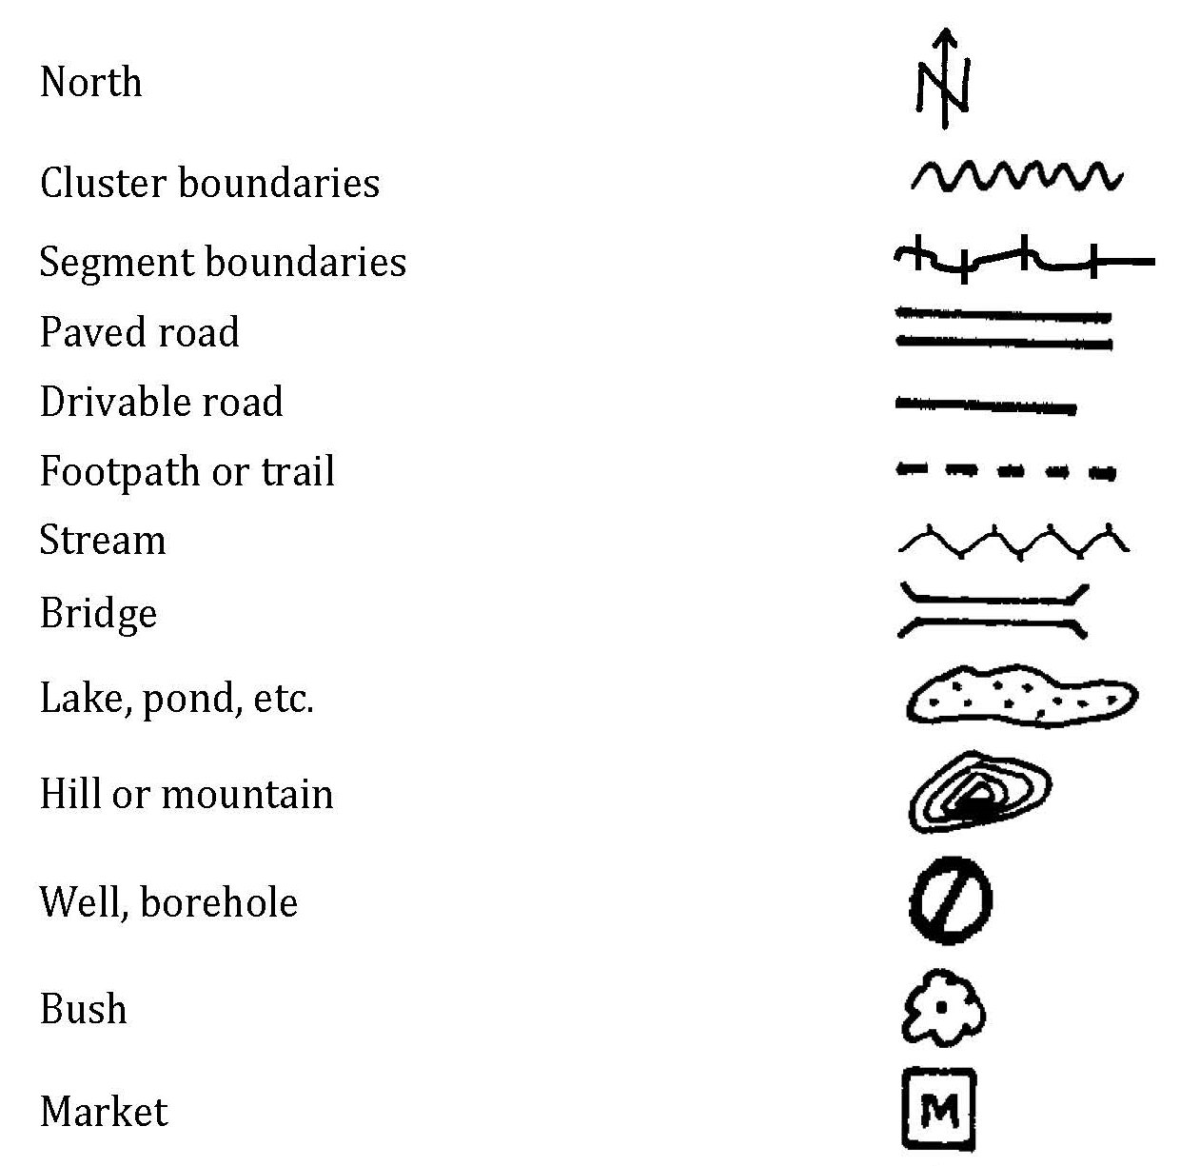
Symbols

Slide 8
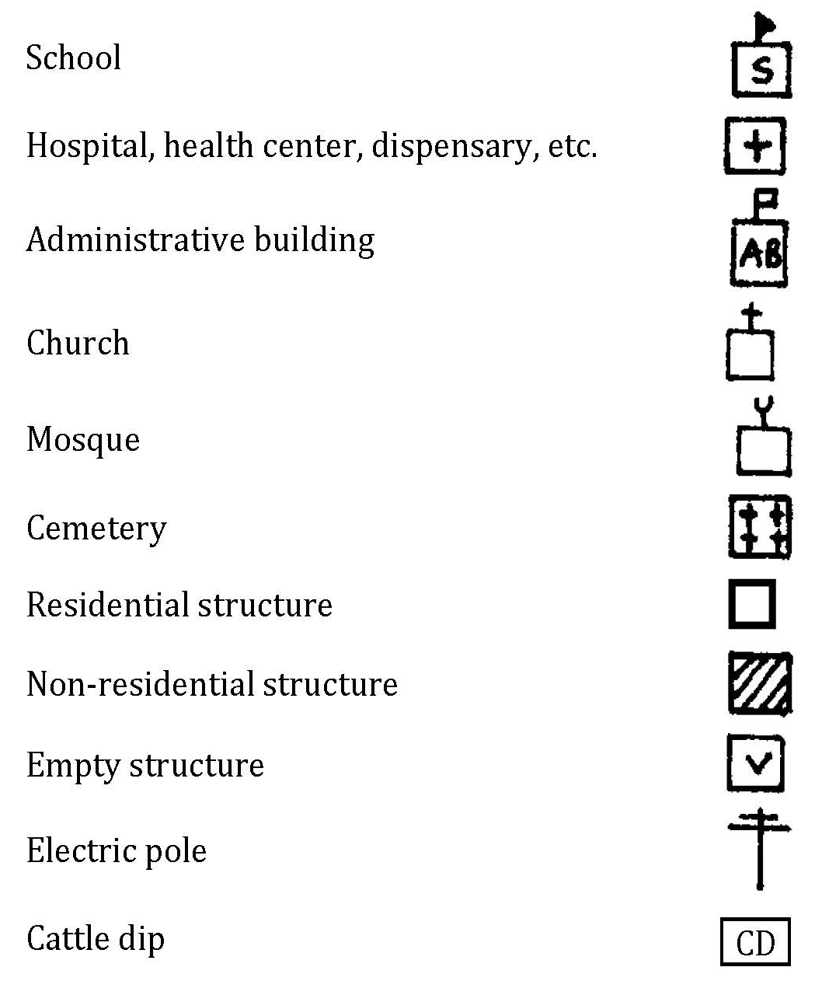
Symbols

Slide 9
How to orient a map?
Indicating North correctly on the map is very important. The compass included in the GPS unit is the main tool to find the right orientation. As an alternative, you can also find the right orientation as follows:
Step one: orient yourself on the ground:
Locate the North. The sun rises in the East and sets in the West. When facing East, the North will be on your left, and the south to your right.
If you are drawing your cluster map in the morning, stand directly facing the sun, and hold your LEFT arm straight out to the side. This is NORTH.
If you are drawing your map in the afternoon, stand directly facing the sun, and hold your RIGHT arm straight out to the side. This is NORTH.
Step two: orient the map
Stand facing North. Hold the map horizontally and turn it so that it is facing the same direction as you. Draw an arrow on the map to indicate North direction.

Slide 10
Mapping sampling & targets
[Region name]
Mixed
Rural
Region
Stratum
Cluster
Urban
[insert number]
[insert number]
XX per cluster
XX per cluster
Households
XX per cluster
[insert number]

Slide 11
Cluster sampled for baseline
[INSERT MAP OF SURVEY AREA SHOWING CLUSTER BORDERS]

Slide 12
Mapping tools for data collection
Mapping tools included in mapping folder for data collection:
Basemap
Cluster identification form
Detailed map of the cluster
Enumeration form

Slide 13
Basemap
Basemap:
Typically carried-out for most recent country census
Provide information about enumeration areas (EA) location, their boundaries and how to access

Slide 14
Basemap
[INSERT LOCAL EA EXAMPLE]

Slide 15
Cluster identification form
Cluster identification form:
Provide information about the name and assigned number (identifier) to the administrative area, the sub-administrative area, the village, the cluster, the type of residence; the name and phone # of the local leader and/or the guide
Also include instructions on how to get to the cluster and any information that can be used to find the cluster and its boundaries and any difficulties encountered during mapping

Slide 16
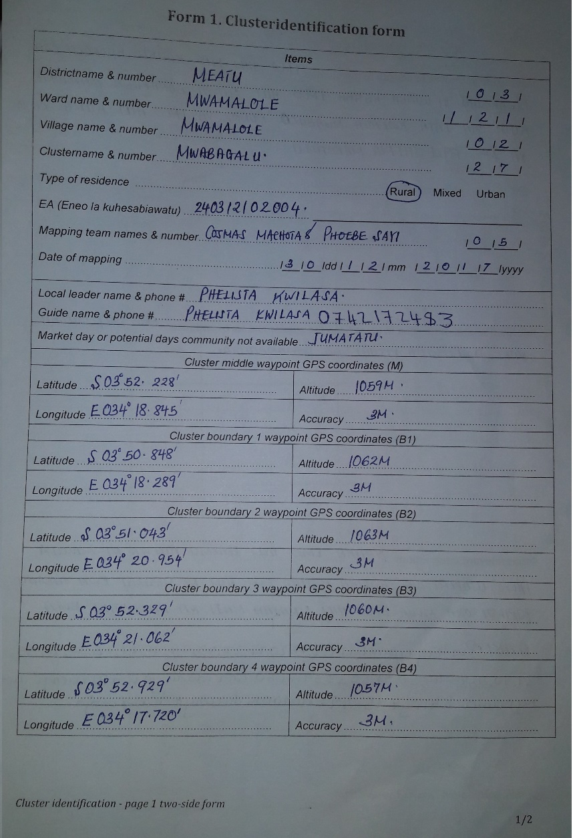
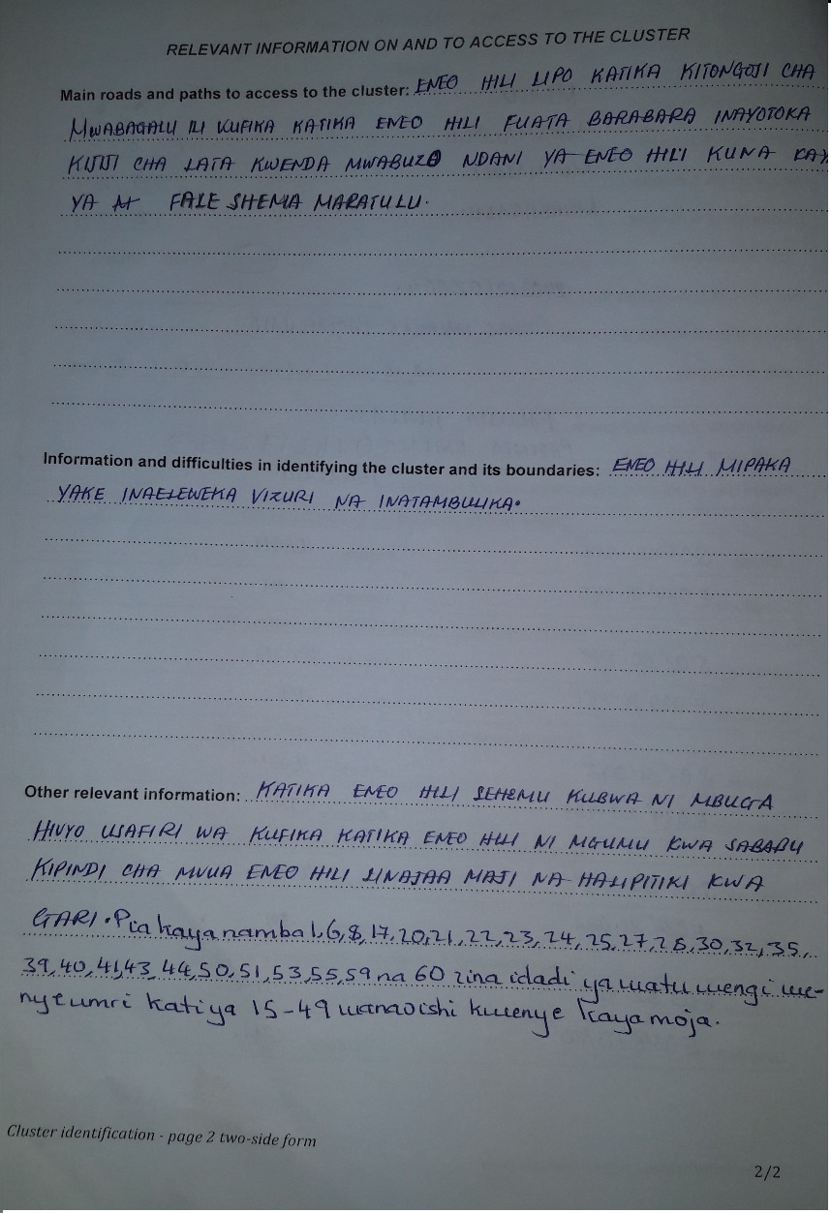
Cluster identification form
[REPLACE WITH LOCAL EXAMPLE IF POSSIBLE]

Slide 17
Detailed map
Detailed map of the cluster:
Use the cluster map to identify boundaries, landmarks and location of structures in the cluster
Use map key/legend to read the map

Slide 18
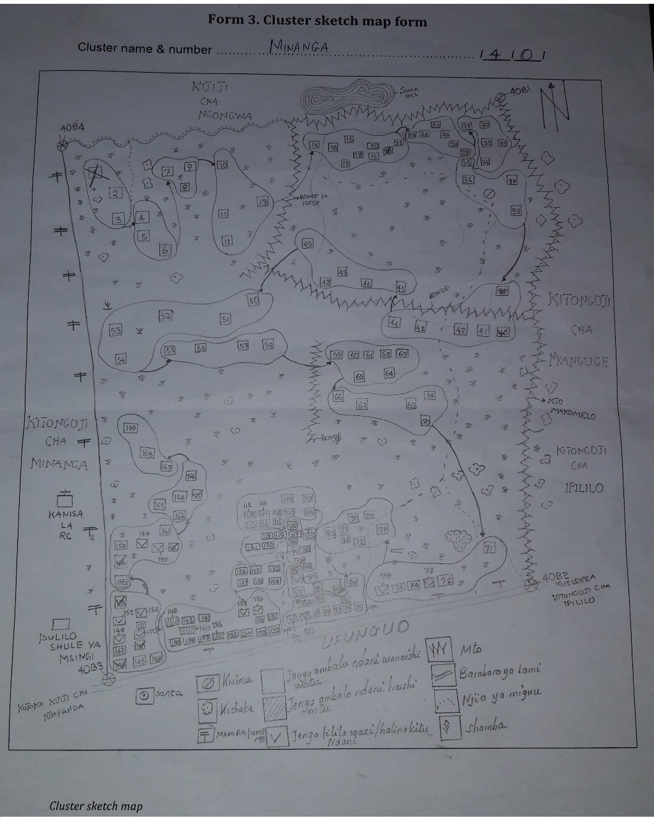
Detailed map

Slide 19
Enumeration form
Enumeration form provides:
Sampled household number. This number is assigned after HH sampling and must be used as household identifier instead of the household sequential number provided during mapping (column (2)).
Column for Address/description of structure provide any description of the structure and any details that help in locating it.

Slide 20
Enumeration form
Enumeration form provides:
Name, common name and phone # of the head of the household help to locate and identify the household
Numbers of women 15-49 years old and of men 15-49 years in the household are mainly useful for assigning comparable or balanced workload to interviewers. Those numbers are approximate numbers and interviewers should probe as per interviewer’s manual to get more accurate numbers.
The column for observations records any special information about the household or structure

Slide 21
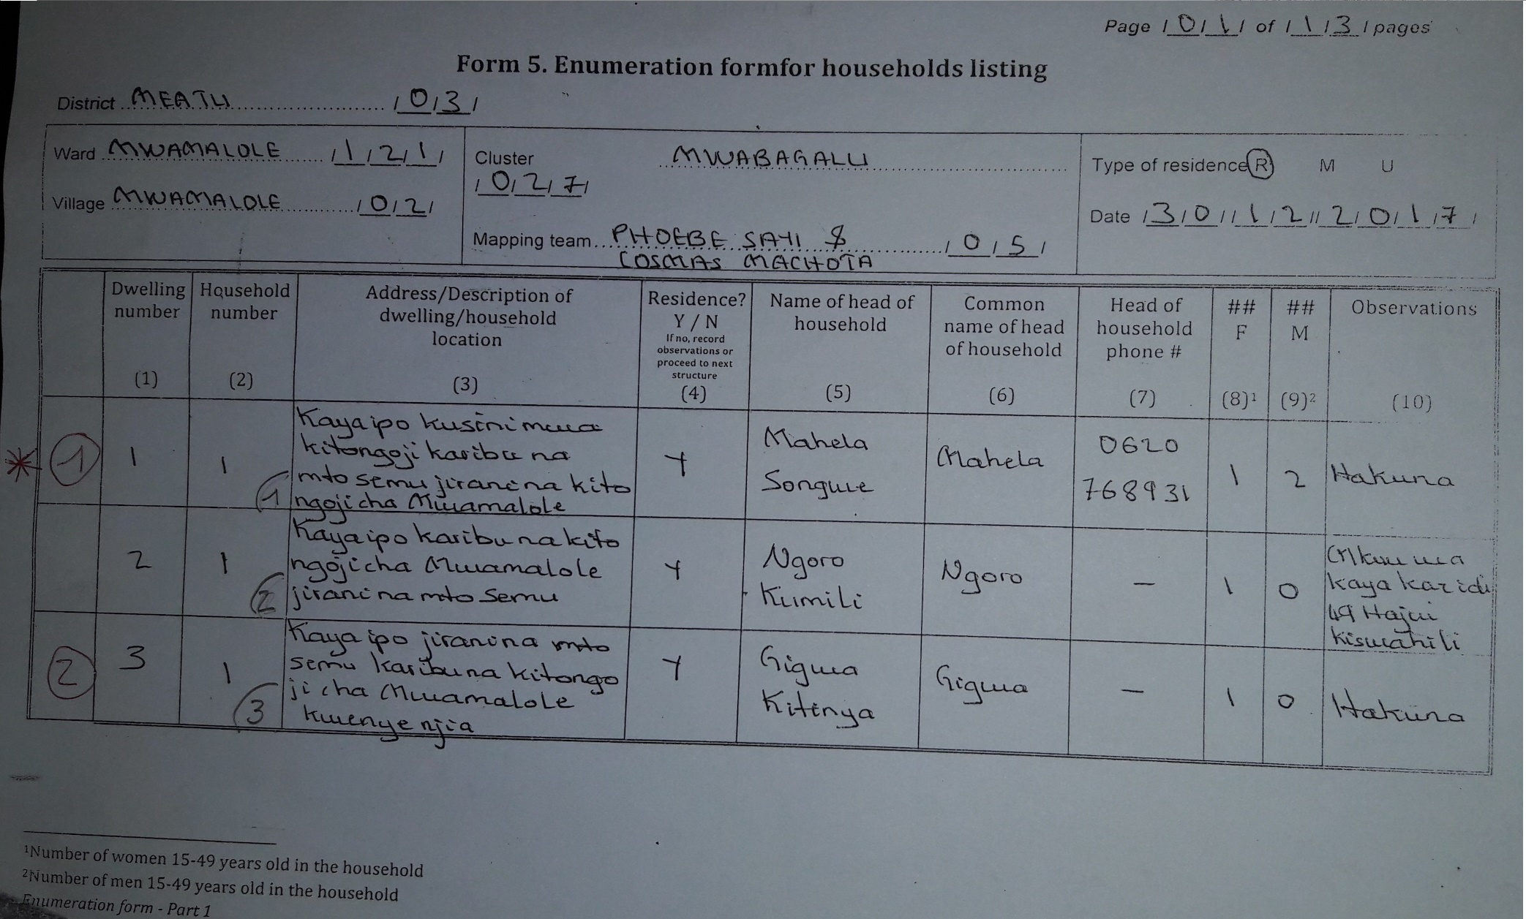
Enumeration form
[REPLACE WITH LOCAL EXAMPLE IF POSSIBLE]

Slide 22
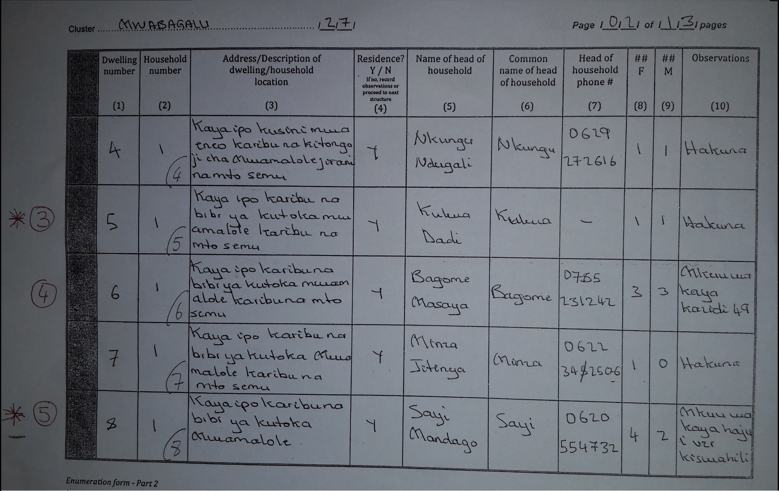
Enumeration form
[REPLACE WITH LOCAL EXAMPLE IF POSSIBLE]

Slide 23
Tips for using mapping materials to locate HHs
Prepare one mapping folder per cluster comprising the needed mapping tools for data collection
Make sure you are in the right village and cluster for data collection
Use the cluster map and description of the structure location in the enumeration form to locate the HH
In addition to the name of the head of HH, probe using the common name to help identify the appropriate person and HH
Use the phone # of the head of HH only if you are not able to locate or identify the HH using the other information in both the location form and the enumeration form
Collaboration & assistance of local leaders or people may help to identify households
However, DO NOT rely on guides to locate all HHs

Slide 24
Thank you

