Slide 1
Training of Mappers

Slide 2
Project overview and information
Introduction
Welcome
Introduction of trainers and trainees
Project presentation
Administratitve information
Logistics

Slide 3
Agenda
[insert screen shots of the agenda]

Slide 4
Overview mapping
Objective:
Create a complete and updated list of households and their locations for sampled clusters/Enumeration area (EA)
List households for survey second stage sampling
Draw a sample of households and individuals representative of the entire region
In brief, consists in:
Visit sampled clusters/EAs
Draw maps of clusters/EAs and structures
List all households within cluster/EA
Mobilize/sensitize community about data collection

Slide 5
Training objectives & format
Training objective:
Become familiar with a systematic mapping approach or random sample
Present the tools and how to use them
Share mapping experience
Format:
PP presentations
Reading
Hand-on exercises/homework assignments
Discussions
Demonstration
Field practice
See manual

Slide 6
Mapping assistants’ roles
Each team is comprised of mappers & enumerators working together
Contact local authorities in their assigned clusters to inform them about the mapping
Identify cluster boundaries, in consultation with local authorities
Draw a detailed sketch map showing the location of the cluster, features and of all the structures it contains
List all the structures and households in the cluster in a systematic manner
Complete all the required forms
Transfer all completed forms and materials to the supervisor or to the central office
Whether allow mark the structure number on the door or doorframe of all the structures within the clusters
Perform mobilization and sensitization in community about the forthcoming survey
Inform supervisors or survey coordinators about problems encountered in the field and follow their instructions for resolving them

Slide 7
Supervisors’ roles
Each supervisor supervises [insert number] teams
Obtain base maps for all clusters selected for her/his assigned supervision area
Assign clusters and workload to teams
Ensure that all mapping materials (manual for mapping, forms, supplies, etc.) are obtained before going to the field
Plan and organize fieldwork logistics (e.g. arranging for transport and accommodation, obtaining introductory letter, identifying and contacting local authorities and village leaders in each cluster to inform them about the mapping operation and to obtain their cooperation)
Monitor and verify that the quality of work is acceptable (location and boundaries well defined, structures on map match with structures on list on households, number of households well enumerated, etc.)
Ensure that each cluster has been fully covered and listed
Receive and review duly completed listing forms and maps and ensure that they are safely stored at the central office

Slide 8
BASIC PRINCIPLES OF MAPPING

Slide 9
Definitions
A cluster is the smallest geographical statistical unit for a survey consisting of a number of adjacent households in an area.
May correspond to an EA or a segment of a large EA with well-defined boundaries.
May correspond to a hamlet which is a sub-division of a village, to part of a hamlet or a group of hamlets
A cluster detailed map is a map of the cluster showing its boundaries and location in relation to its environment
Contains major landmarks in the hamlet (roads, paths, schools, health centers, wells, hills, streams, etc.)
The location of structures/ dwellings is approximatively marked on the map

Slide 10
Definitions
A structure is a freestanding building, for a residential or commercial purpose. It may have one or more rooms in which people live
May be an apartment building, a house, or a thatched hut
Within a structure, there may be one or more dwelling (or housing) units
A dwelling unit is a room or a group of rooms normally intended as a place of residence for one household
Could be a single house, an apartment, or a group of rooms in a house
However, a dwelling unit can also be shared by more than one household
Within a dwelling unit, there may be one or more households

Slide 11
Definitions
A household consists of a person or group of persons, related or unrelated, who live together in the same dwelling unit, who acknowledge one adult male or female (15 years or older) as the head of household, who share the same living arrangements, and are considered as one unit.
A group of people living together in the same house but where each person has separate eating arrangements should be counted as separate one-person households
Collective living arrangements such as hostels, army camps, boarding schools, or prisons are not considered households
Households are found in dwellings, dwellings in structures and structures in clusters.
Household definition during enumeration operation should match with the definition provided during interviewers training and data collection.

Slide 12
Definitions
Household examples:
A person living with their spouse
A man with his wife or wives and their unmarried children
A man with his wife or wives living with their married children and partnering to provide for certain basic needs (the group recognizes the authority of a single person)
An unmarried man or woman with or without children who is the sole provider for their basic needs
A widow or widower with or without children
A person who rents a room and who does not take his/her meals with the household would be considered as constituting a household
A group of unmarried people who share the same housing unit is considered a household if they recognize the authority of one person as the head of household. Otherwise, they are separate households.

Slide 13
Definition
Tips for identifying households:
Probe for potential multiple households in a dwelling/compound (who makes decisions and supports members of the family, where people sleep, whether people eat together, etc.). For large households, please make a note on the enumeration form so that data collection team can plan accordingly.
For situations where there may be multiple wives: If it is confirmed that the husband is the provider of both (or more) families and the wives (and families) live near each other, this will count as one household (women and children from all the families should be counted). Make a note on the enumeration form in the observation column.
For traditional doctors who may have many patients staying at their home, please register only those who are usually living there i.e. themselves and any family members or their visitors (that are not patients).

Slide 14
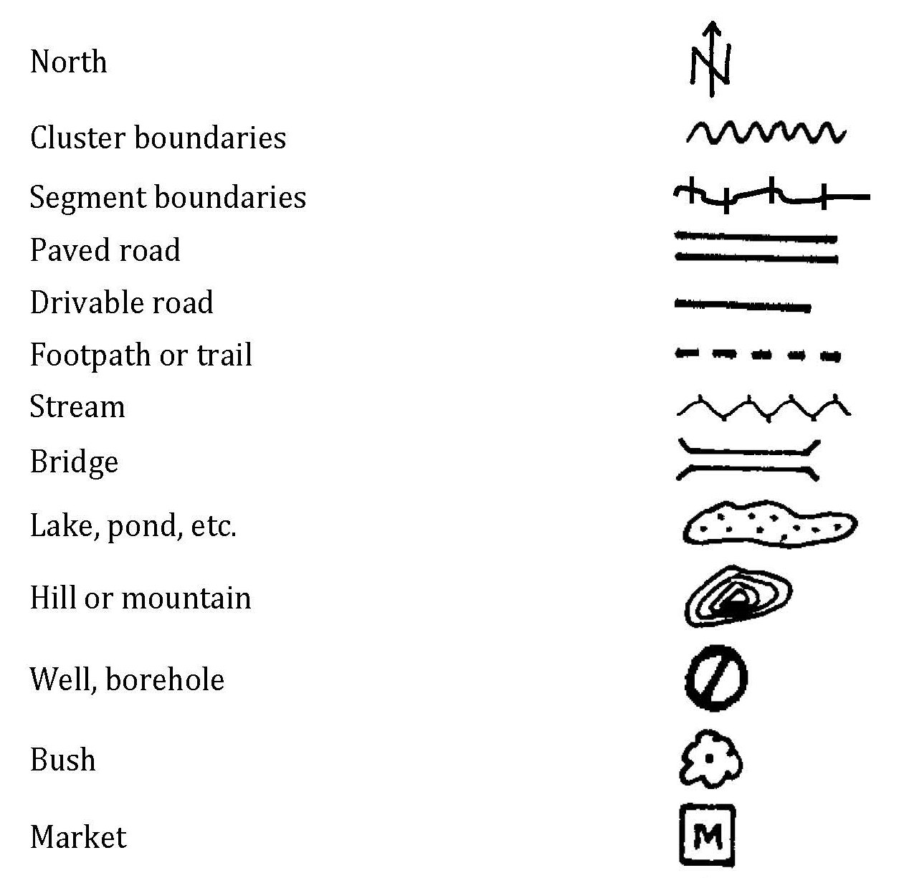
Symbols

Slide 15
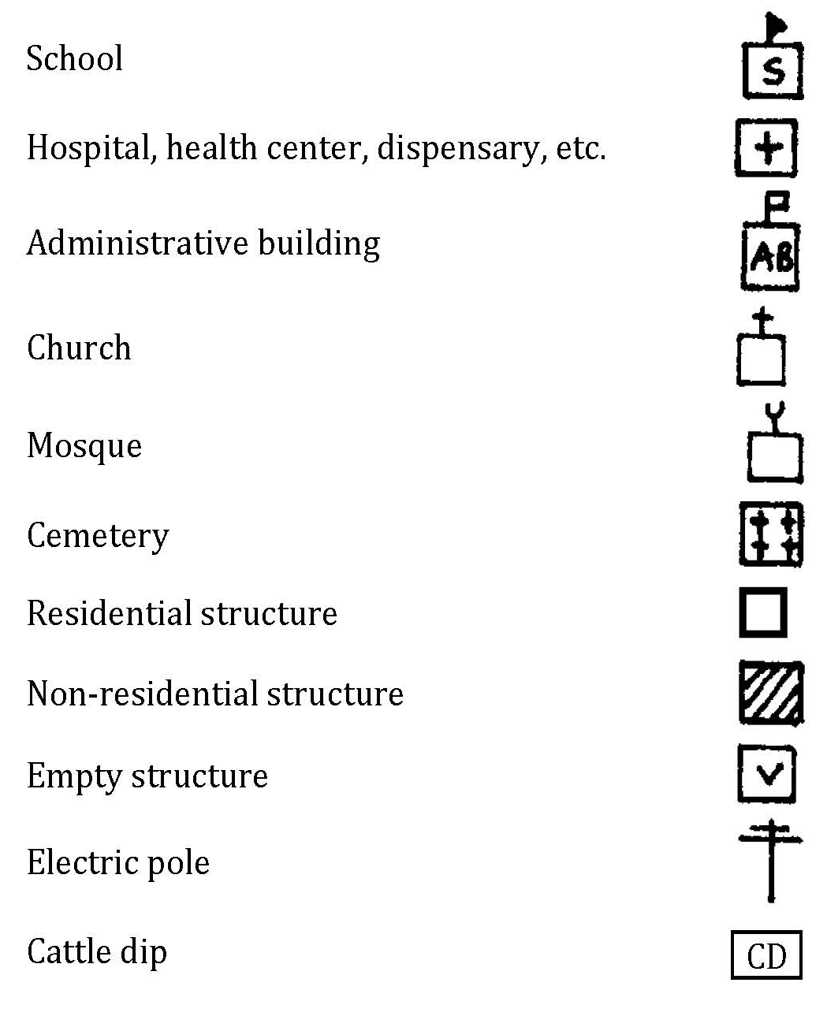
Symbols

Slide 16
How to orient a map?
Indicating North correctly on the map is very important. The compass included in the GPS unit is the main tool to find the right orientation. As an alternative, you can also find the right orientation as follows:
Step one: orient yourself on the ground:
Locate the North. The sun rises in the East and sets in the West. When facing East, the North will be on your left, and the south to your right.
If you are drawing your cluster map in the morning, stand directly facing the sun, and hold your LEFT arm straight out to the side. This is NORTH.
If you are drawing your map in the afternoon, stand directly facing the sun, and hold your RIGHT arm straight out to the side. This is NORTH.
Step two: orient the map
Stand facing North. Hold the map horizontally and turn it so that it is facing the same direction as you. Draw an arrow on the map to indicate North direction.

Slide 17
MAPPING SAMPLING & TARGETS

Slide 18
Mapping sampling & targets
[Region name]
Mixed
Rural
Region
Stratum
Cluster
Urban
[insert number]
[insert number]
XX per cluster
XX per cluster
Households
XX per cluster
[insert number]

Slide 19
Preparing for fieldwork
Mapping planning and supplies
Team organization
Contacts
Supplies and documents

Slide 20
Review
What is a household for this study?
What are the main tasks of the mapping assistants?
What do you need as materials/tools for mapping?
How the mappers and enumerators work in the field?
How many clusters are we going to map?
How many households are we going to enumerate/list per clusters?
What is the difference between residential and not residential structures?
Questions? Clarifications?

Slide 21
When arriving in a cluster
Local authorities’ cooperation and assistance from a local leader to identify cluster boundaries and households is mandatory
Mapping teams will proceed as follows for information and sensitization of community leaders and households:
Mapping assistants (MAs) will introduce themselves first to the Village Leader (VEO) and/or the Hamlet Leader and submit introductory letters from [insert name of local ethics committee and organization]
The VEO should have received information from a team member before mapping day
The VEO should be the one to introduce the team to the Village Chairperson and the Hamlet Leader
MAs will present the purpose of the mapping and review the key messages with the VEO, Village Chairperson and/or the Hamlet Leader at the time of visit

Slide 22
Procedures after arriving in a cluster
Ideally, the Hamlet Leader will serve as guide by introducing the team to the households to map and moving with the team to every household
Community members feel more comfortable when there is someone that they trust introducing the mapping team
In each household, the mapping assistants should:
Introduce themselves,
Read the information/recruitment script presenting the purpose of the mapping
Present the key messages of the data collection,
Request agreement from the household head to enumerate the household
Answer any questions that the household head / household members may have at this time.
Enumerated households will be informed that only [insert number from sampling] households will be selected for data collection and their household may or not be selected

Slide 23
Completing a cluster location/identification form

Slide 24
How to draw a cluster sketch/map
Performing mapping fieldwork
Locating the cluster
Drawing the sketch of the cluster
Practice drawing a cluster map

Slide 25
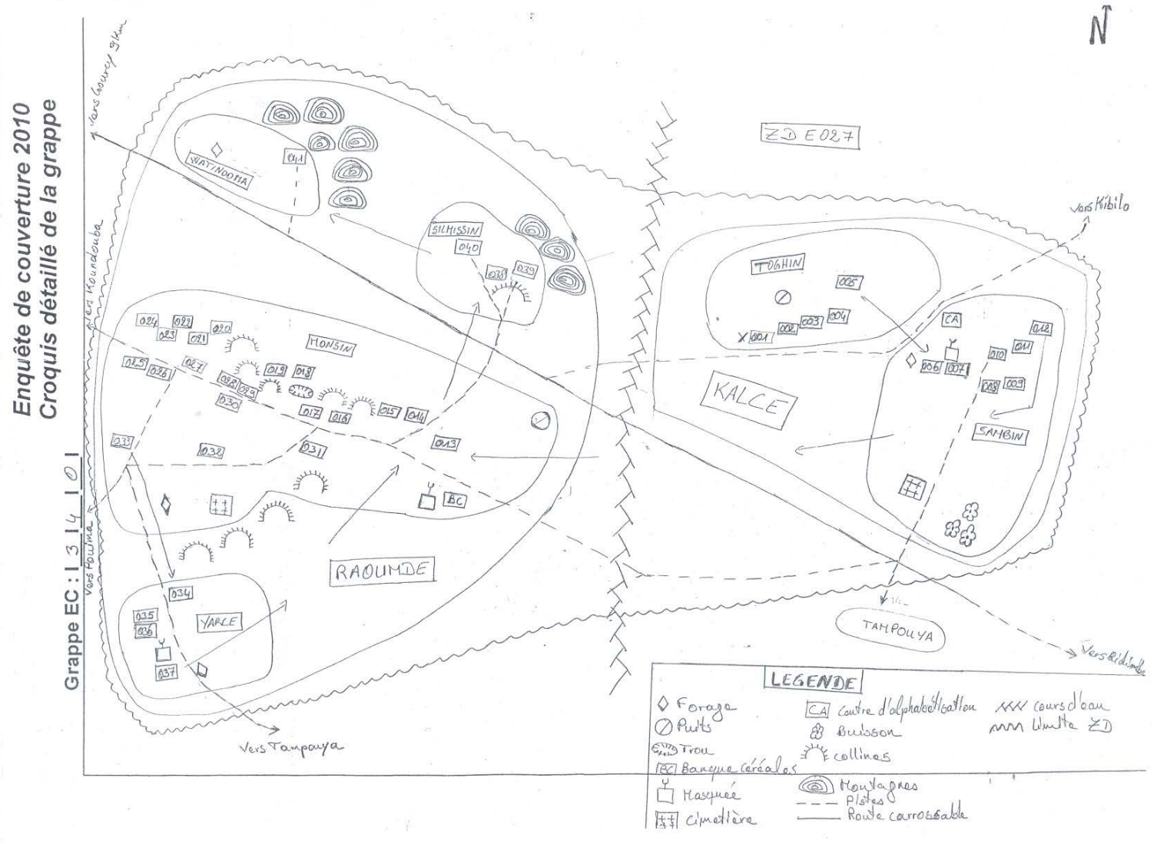
Drawing a cluster map/sketch

Slide 26
Cluster Segmentation

Slide 27
How to segment a cluster
Principles for segmenting a cluster
See manual page [insert page number]
How to segment a cluster:
Draw a location map of the entire EA in the first tour as described previously
Using clear boundaries such as roads or rivers, divide the EA into segments of roughly equal size in terms of the number of households
Mark the boundaries of the newly created segments on the location map of the EA
Number the segments sequentially, starting at the northernmost point on the map and moving clockwise around the EA
For each segment, do a quick count of the number of dwellings and calculate the percentage and cumulative percentage of dwellings

Slide 28
How to segment a cluster
Using the Segmentation Form, record the EA identification information, the segments numbers, and the size of each segment in the appropriate columns (number of dwellings, percentage and cumulative percentage)
Compare the cumulative percentage of dwellings with the random number provided on the Segmentation Form
Select the first segment for which the cumulative percentage is greater than or equal to the random number
Draw a sketch map of the selected segment and list all the households found in the selected segment, as previously described. The selected segment corresponds to a cluster for the survey.
This assumes that one dwelling corresponds to a household
Percentage of dwellings is obtained by dividing the number of dwellings in each segment by the total number of dwellings in the EA
Cumulative percentage corresponds to the sum of the percentage of dwellings in a given segment plus the percentages of dwellings in sequentially preceding segments.

Slide 29
How to segment a cluster
Segment sequential number (1) | Number of dwellings (2) | Percentage of dwellings (3) | Cumulative percentage of dwellings (4)
1 | 118 | 34% | 34%
2 | 116 | 33% | 67%
3 | 114 | 33% | 100%
Total | 348 | 100%
Exercise on segmentation
Random # = 48

Slide 30
Filling in an enumeration form
Completing an enumeration
See manual [insert page number]
Demonstration of completing an enumeration
Practice filling in an enumeration form

Slide 31
Filling in an enumeration form: Scenario
Your team has completed the mapping of the rural cluster named “Jalala” which is in the Sapiwi Village and Ward within the Bariadi District
The northernmost structure has a woman named Janet (age 35) who lives with a 16 year old girl and her husband lives in Dar.
The second structure is the VEO’s household (Benedict). Benedict has a wife age 40 and three children; a girl age 17, a boy age 15 and a boy age 8. He is living with his brother (Maïga) who is married to a woman age 30 and their daughter who is age 15. His eldest son (Dave) is living in the same compound with his wife age 23.
The third structure is the home of a widow (Nancy) aged 60 who lives alone.
The fourth structure is near the school and has 4 unmarried students (all males age 20) living together in the same housing unit. They all recognize that the student who owns the household (Athuman) is the authority figure.
The fifth structure has a man (Richard, age 30) living with his wife (age 29) and his mother (age 60) and their child (age 6). There is also a cousin (Paul, age 25) who rents a room in the household but does not take his meals with the family.
In the 6th structure, a boy (Steven age 14) answers the door. He lives only with his mother (age 30) who is deaf and cannot answer questions

Slide 32
GPS waypoint
GPS data
Parameters:
Longitude
Latitude
Altitude
Accuracy (<=5m)
Location:
Perimeter/boundaries track
Middle/Centroid waypoint

Slide 33
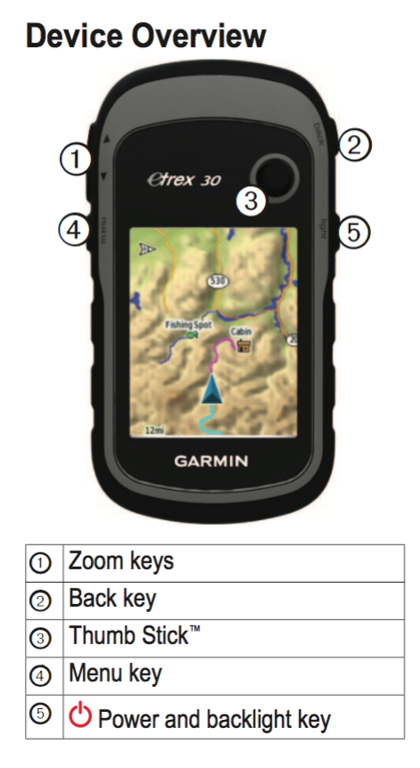
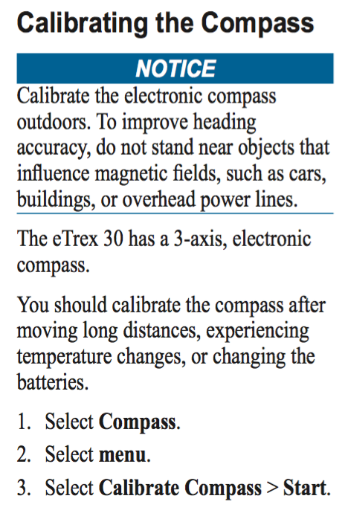
GPS Setup

Slide 34
Record tracks (EA perimeter)
Complete a first walk around the perimeter
When ready to start the second walk:
Select “Track Manager”
Select “Current Track”
Select “Clear Current Track”
Complete second walk around perimeter
Select “Track Manager”
Select “Current Track”
Select “Save Track”
Enter Name “ABP#”
Select “Done” and ”Yes”

Slide 35
GPS waypoint (centroid)
Steps for recording a waypoint
Find a place with a clear view of the sky
Check that the estimated accuracy of the reading is less than or equal to 5 meters
Make the waypoint reading near the centre/middle of the cluster
Mark the waypoint
Rename the waypoint to match the cluster number (e.g. AB45)
Save the waypoint on the GPS unit
Record the waypoint location information (latitude, longitude, altitude, accuracy) on the identification form
Draw a circle on the sketch map of the cluster at the location where the waypoint is captured

Slide 36
Create a waypoint (centroid)
Select Mark Waypoint
Select top box
Change name to “ABC#”
Record location coordinates, elevation, and cluster ID on paper
Select “Done”
Practice recording a waypoint and a perimeter

Slide 37
Perimeter and Waypoint Activity
In teams of 2, create a perimeter track [insert location for exercise]
Complete first walk around the perimeter
Clear track at the beginning of second walk
Save the track as “ATP” after completing second walk
Archive this track and view it on your GPS device
Set a waypoint at the front entrance [insert location for exercise]
Save the waypoint as “ATC”
Record the longitude, latitude and altitude of this point

Slide 38
Checklist for and after mapping
Introduction to the village leader (VEO) and/or the Hamlet Leader and submission of introductory letters from [insert local ethics committee and implementing organization]
The VEO should have received prior information from a team member before the mapping day
The VEO introduces the team to the Village Chairperson and the Hamlet Leader
Presentation of the mapping operation and review of the key messages with the VEO, Village Chairperson and/or the Hamlet Leader at the time of visit
Ideally, the Hamlet Leader introduces the team to the households to map and moves with the team to every household
Community members feel more comfortable when there is someone that they trust introducing the mapping team.
In each household, the mapping assistants should:
Introduce themselves
Read the information/recruitment script presenting the purpose of the mapping
Explain the key messages of the data collection
Request agreement from the head to enumerate the household
Answer any questions that the household head / household members may have at this time

Slide 39
Checklist for and after mapping
Draw the necessary sketches/maps, fill the different forms (identification, location detailed sketch, enumeration and segmentation if needed) and record GPS coordinates
Remind the head and/or member(s) of the household of the upcoming data collection and its anticipated period before leaving each household and the community leaders before leaving the hamlet
Thank the household head / household members and community leaders for their time and cooperation
Bring mapping outputs to the supervisor who will assess their quality and then send them to the central office

Slide 40
Thank you

